Slide 1
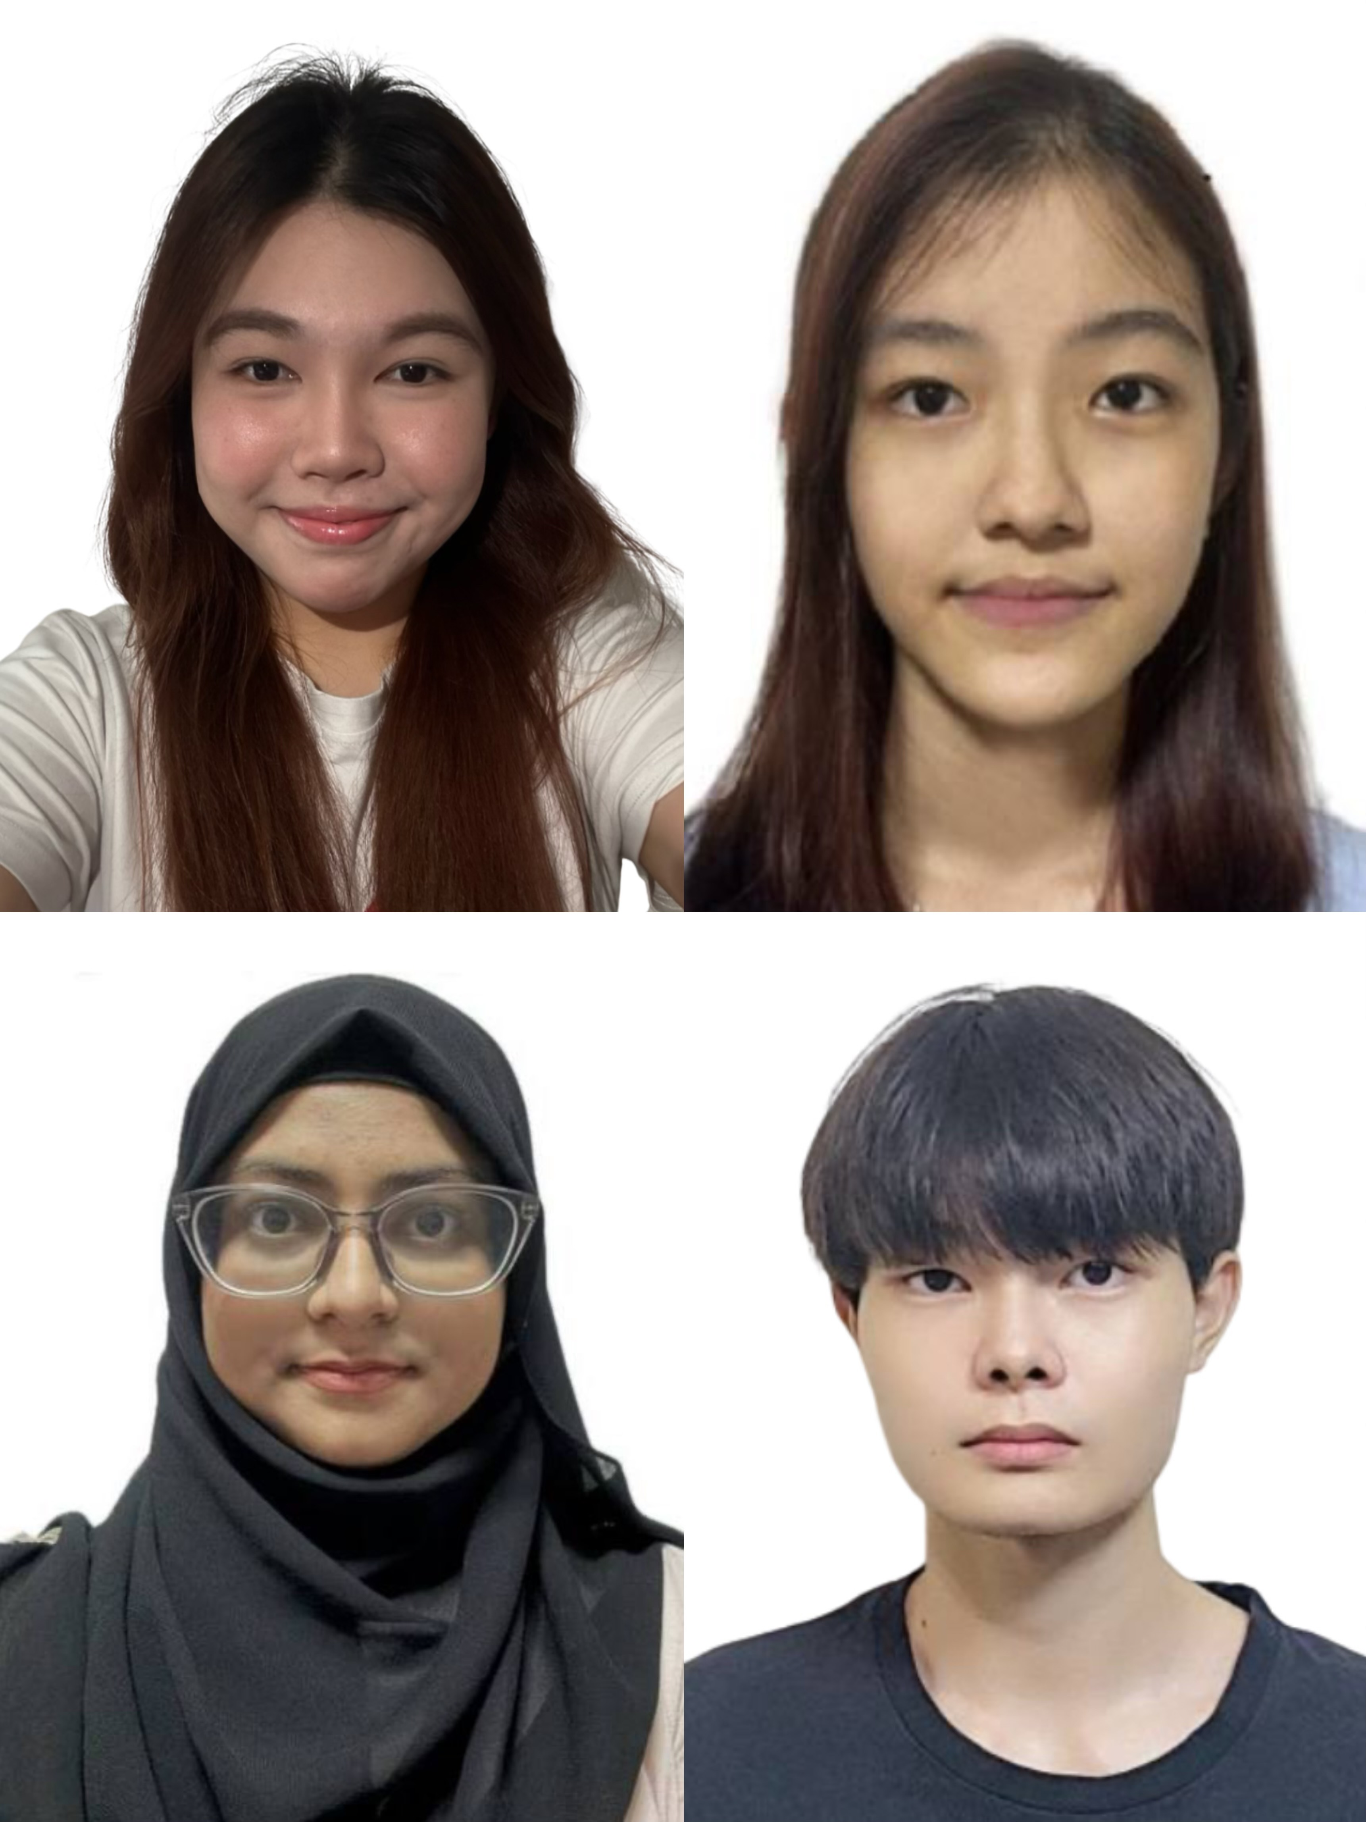
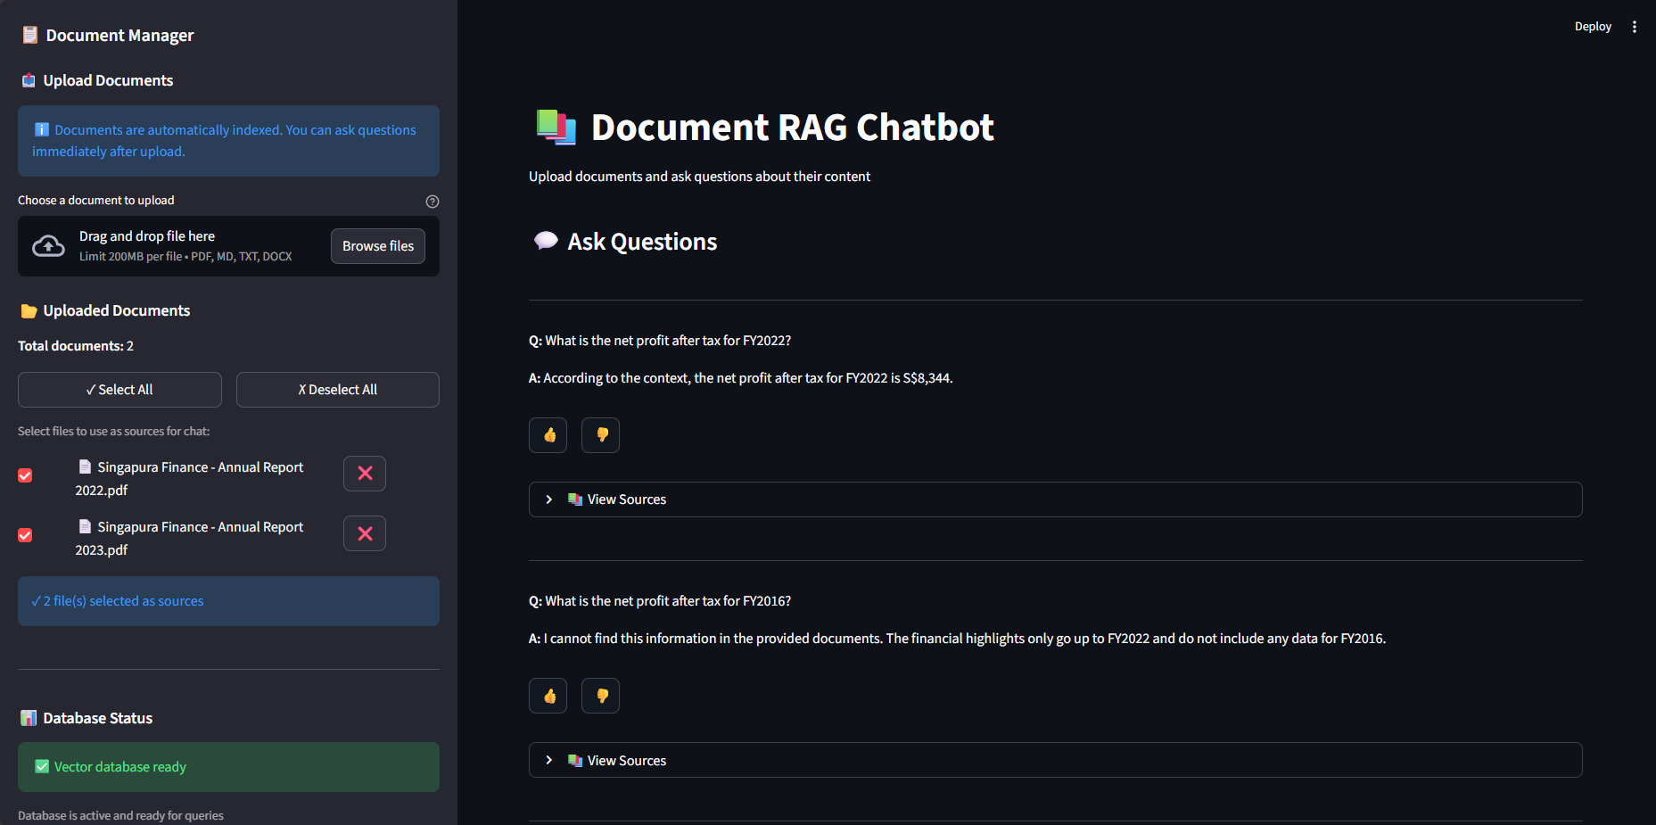

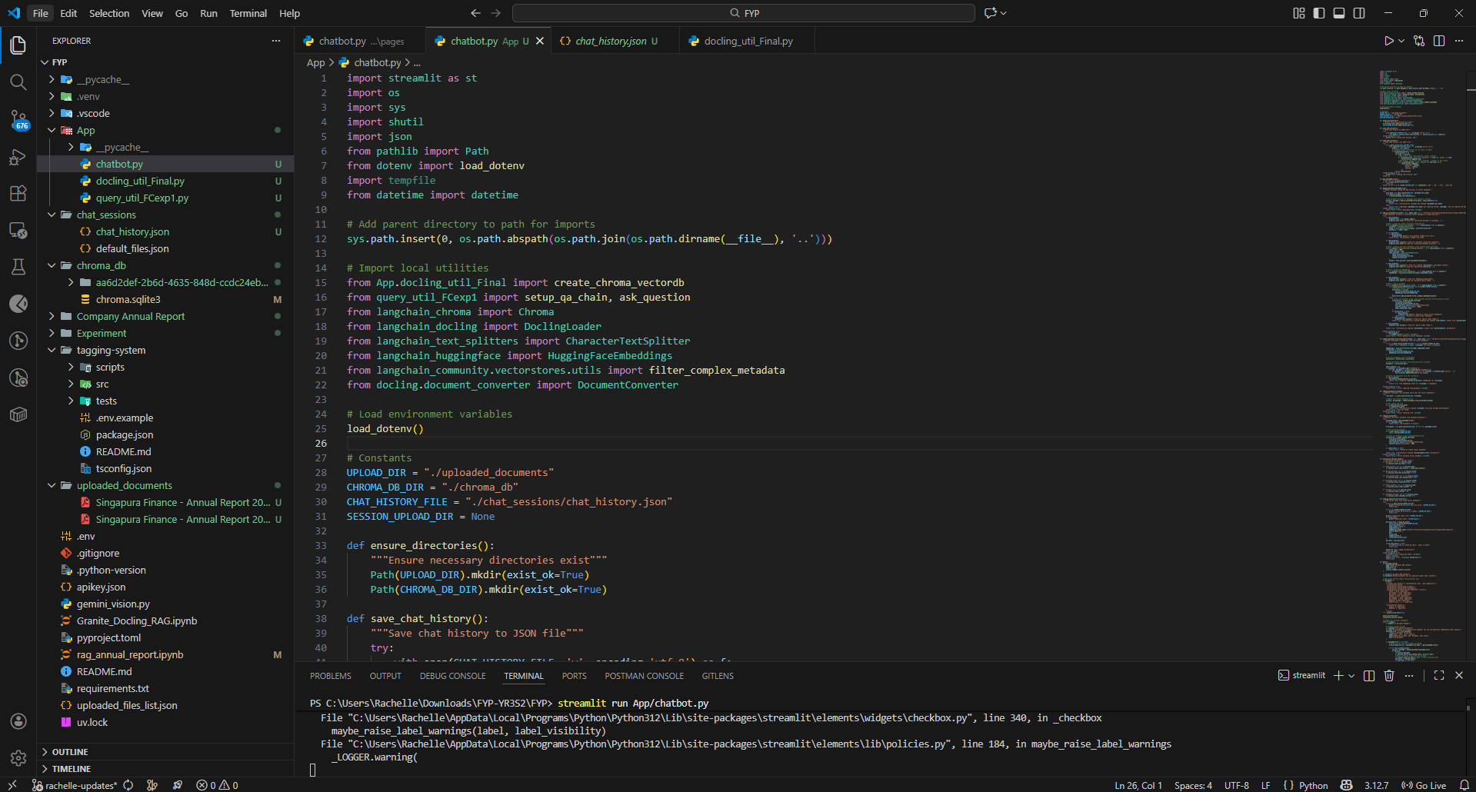
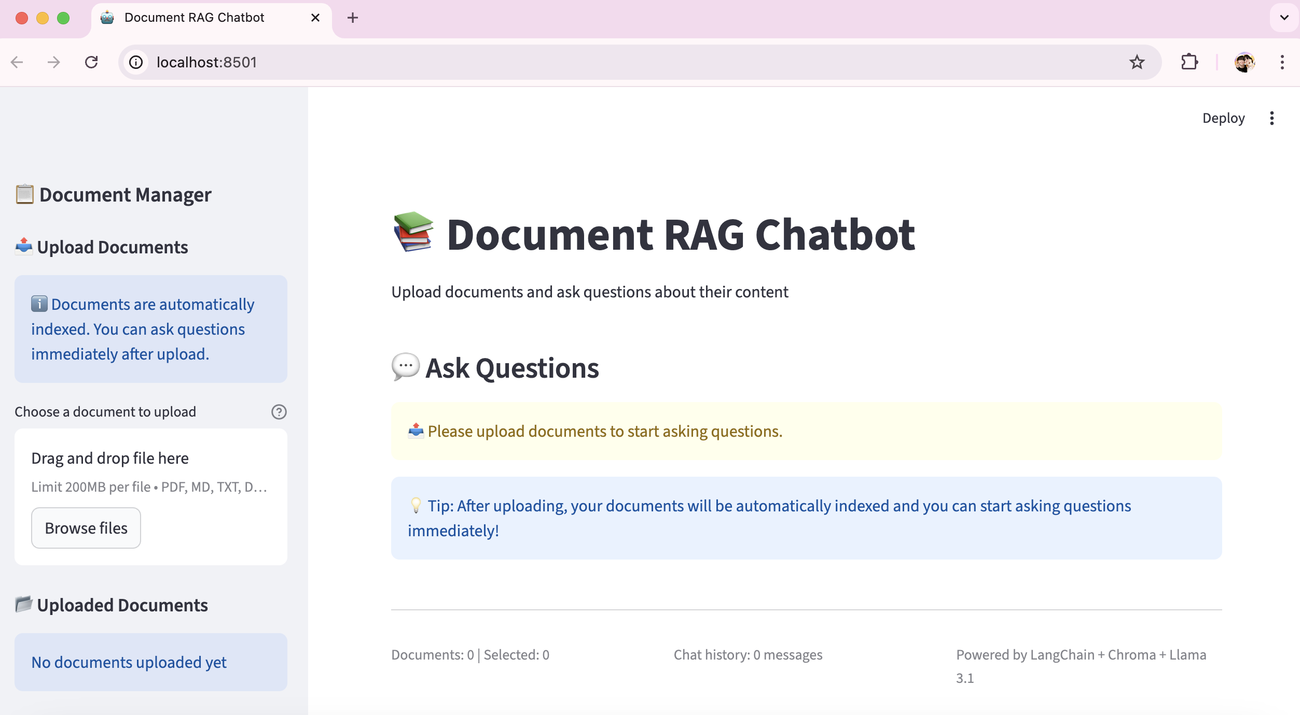
Intelligent Document Retrieval & Question Answering System Partner Organisation: IBM
Project Overview
Today, both organizations and individuals have to deal with a large number of documents such as reports, manuals, research papers and emails. These documents contain useful information but are often difficult to search through one by one. Traditional keyword search systems does not work well because they only look for words that match and do not understand what the user really wants. And as a result, users may get irrelevant results or long lists of documents instead of clear answers straightforward answers which leads to a waste of time and reduces productivity.
Our solution is an Intelligent Document Retrieval and Question Answering System that uses a RAG approach. This system converts normal documents into a more interactive knowledge base that users can easily search for. Firstly, documents that are uploaded by the user will be processed and stored in a way which allows the system to understand their meaning. When a user asks question, the system finds the most relevant parts of the documents and use them to generate accurate answers. This approach helps the system give better results than traditional keyword search by focusing on meaning rather than just matching words.
Our system is built using a modern and modular technology stack. Python is used for the backend with Langchain mangaing the overall RAG workflow. Documents are processed using Docling while embeddings and semantic search are handled using sentence-transformers and chroma database. Llama is being used as the language model which is integrated to generate answers based on the retrieved information. The web interface is developed using Streamlit which allows user to easily upload documents and ask questions. Overall this technology stack makes the system accurate, scalable and easy to use.
Shows how many documents are uploaded and the selected documents to answer questions, shows number of past messages.
Web interface of after uploading documents and user starts to ask questions and there are responses.
Team Members
Yeo Rui En, Lim Iy Xin Rachelle, Hashireen D/O Abdul Khadar, Luo Cheng Nuo
Supervisor
Mr Tan Poh Keam
Web interface when user first enters website, before uploading any documents.
Notes:
NOTES
Refer to write ups in ‘Past Projects for Reference’ Booklet for Project overview write ups - Student Academic - Project (sharepoint.com)
ENGLISH – British. E.g. organisation VS organization
Font: RP approved font - Arial family only.
Header: Arial Bold
Copy text: Arial regular or Arial Bold. Use Emphasis of SOI’s orange colour in moderation.
Picture frame – Give a 4.5 or 6pt orange outline.

